Slide 1
Unit- 4 Oral Communication Skills
What is communication etiquette?
Communication etiquette refers to the accepted ways of communicating with others in the workplace.
Good communication etiquette includes behavior and strategies that can help you relay information clearly while maintaining positive relationships with your supervisors, colleagues and clients.

Slide 2
The importance of good communication etiquette
Effective communication within a workplace is a vital aspect of efficient business operations.
Proper communication can ensure that employees interpret the meaning of your message as intended.
The resulting decrease in misunderstandings can contribute to stronger workplace relationships and more productive interactions.
It can also label you as an effective communicator, suggesting that you possess leadership qualities and potentially leading to greater professional opportunities in the future.
There are mainly two types of etiquette: Verbal and non-verbal. But here our major focus is on verbal or oral etiquette.

Slide 3
What are some verbal etiquettes?
Depth of Voice - Deeper voices are considered more authoritative and characteristic of a leader.
Accent - Tone of the voice
Word Choice
Volume & Tempo
Body Language
Body language is equally important in personal interactions as verbal communication. Body language (and facial expressions) help the other person understand so much about what we are communicating.
Personal Space - The space indicates the intimacy with the communicators.

Slide 4
Facial Expressions - Eye Contact - Making eye contact while communicating demonstrates confidence. Of course, there is a fine line between staring inappropriately and being engaged in what the other person is saying. Blinking, nodding, looking off to signal thought, etc., are all methods of effective eye contact. Specifically, they break of the feeling of a staring contest. All of this sounds easy, but I recommend that you practice having conversations with others while focusing on your eye contact.
Stand Up Straight - Standing up straight in communication indicates the confidence and boldness.

Slide 5
Seated Communications - Having a professional conversation while seated requires its own level of practice. You want to make certain you demonstrate engagement in the conversation in any conversation. In casual conversations, however, you also want to appear relaxed and calm. Here are some simple tips for body language while seated.
Lean Forward - Sitting up straight while slightly leaning forward demonstrates engagement. This is particularly important in professional meetings or interviews. It is less important in casual conversations - though you want to still demonstrate engagement in these scenarios.
Feet on the Floor - In a professional meeting, keep your feet on the floor. Crossing your legs tends to make you lean backward and appear too casual. In a casual conversation, crossing your legs and leading back a bit is fine - though always focus on maintaining engagement.
Hand Gestures:- Gestures of the hands increase the effectiveness in oral communication.

Slide 6
Soft skills in Communication
Soft skills are personality traits and behaviors that will help candidates get hired and succeed in their work.
Unlike technical skills or hard skills, soft skills are interpersonal and behavioral skills that help you work well with other people and develop your career.
Soft skills are abilities that relate to how you work and how you interact with other people.
Popular soft skills include communication, teamwork and other interpersonal skills.
Employers look for soft skills in candidates because these skills are hard to teach and are important for long-term success.
Soft skills are different from hard skills, which are technical and job-specific.

Slide 7
Soft or social skills (also called non-technical skills) are those personal values and interpersonal skills that determine a person’s ability to work well with others in a project team.
Soft skills are needed to deal with the external world and to work in a collaborative manner with one’s colleagues.
These skills include effective communication, leadership, and teamwork skills; demonstrating problem solving abilities, initiative, and motivation skills; displaying honesty and strong work ethics.

Slide 8
Soft skills play a vital role for academic and professional success; they help us excel in the workplace and their importance cannot be denied in the emerging information or knowledge society.
Soft skills are needed to deal with the external world and to work in a collaborative manner with one’s colleagues.
There are various components that comprise soft skills. Some are inborn such as confidence, friendliness and whether or not someone has a sociable nature, while others are skills that can be taught or improved upon, such as developing effective communication, organization, and social graces.

Slide 9
A large number of soft skills are known today. However, a different set of soft skills is required for a specific type/nature of work. For our purpose these may include the following:
communication skills
listening skills
presentation skills
interpersonal skills
team skills
leadership skills
Etiquette/mannerism/politeness
cross-cultural skills
language skills, etc.

Slide 10
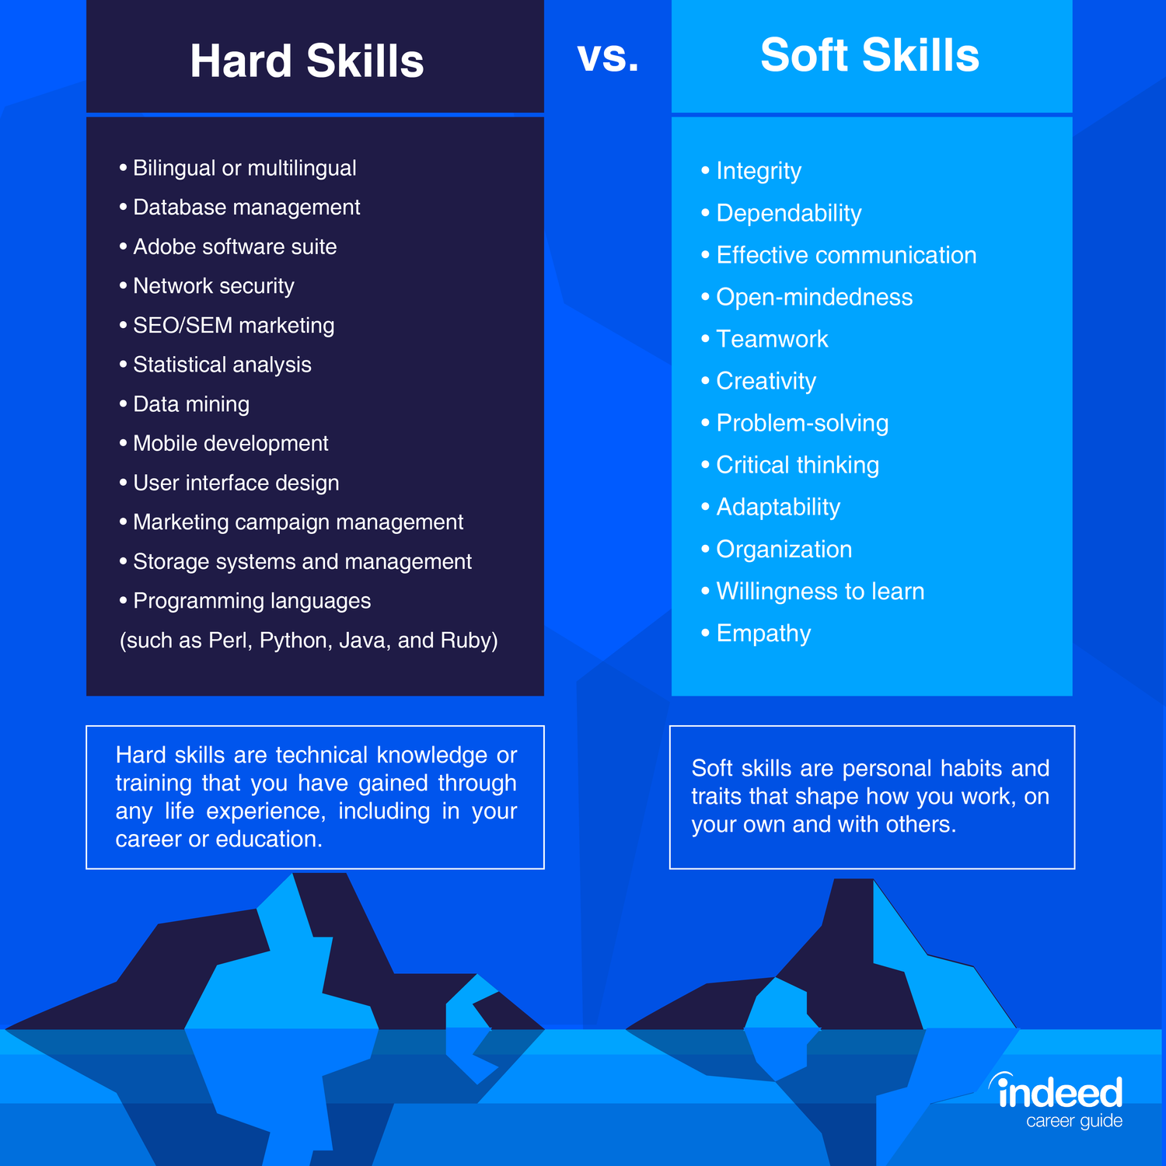
Soft Skills in Communication

